Slide 1
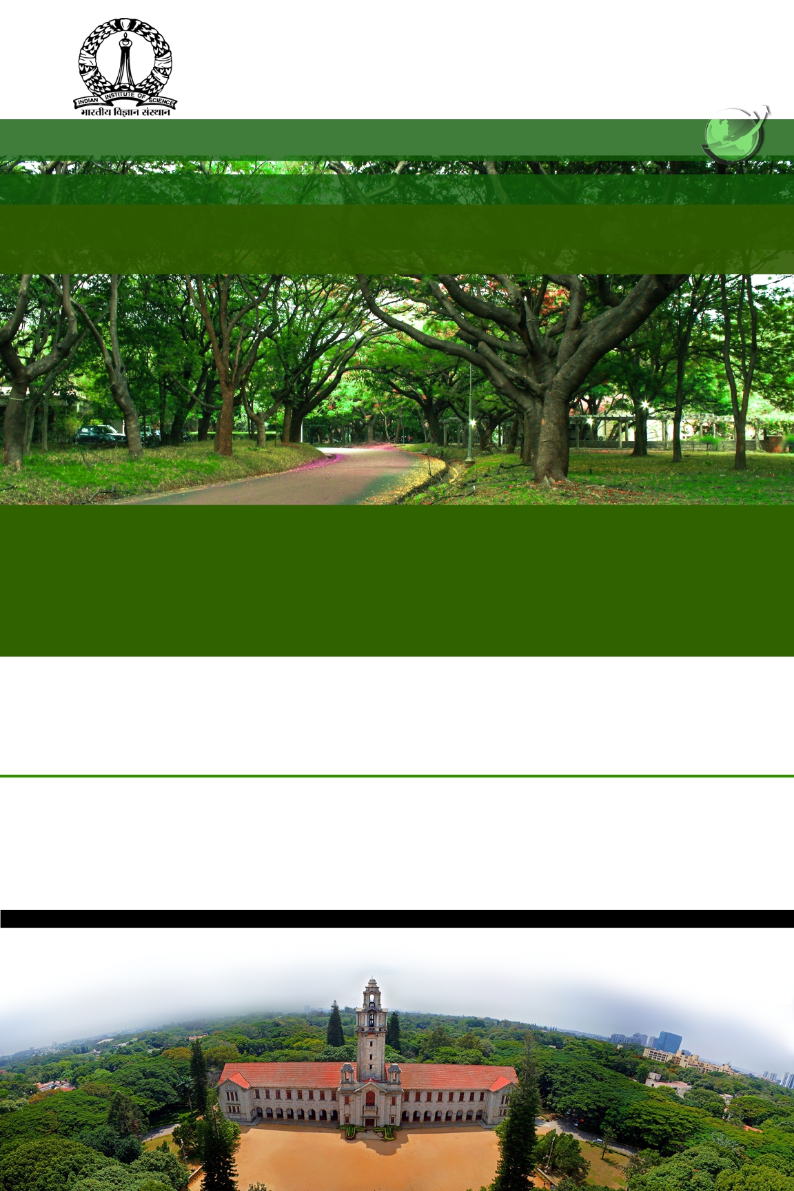
INDIAN INSTITUTE OF SCIENCE, BANGALORE, INDIA
FULL-TIME GRADUATE PROGRAMMES FOR INTERNATIONAL
STUDENTS 2018
ONLINE applications are invited for:
M.Tech (Research) in Engineering
Ph.D. in Science
Ph.D. in Engineering
IMPORTANT dates:
The online application portal
Opens on December 4, 2017, and
Closes on February 5, 2018
Fellowship and Accommodation will be provided to all admitted students
GRE or GATE is STRONGLY encouraged for evaluation
GATE International 2018 will be held in Ethiopia, Sri Lanka, Nepal, Bangladesh, UAE and Singapore. Examination could also be taken at any of the centres in India. Last date for GATE application is October 5, 2017 (http://www.gate.iitg.ac.in)
For eligibility criteria and selection procedures:
http://oir.iisc.ac.in/programmes-fulltime.php
For any other queries, please contact us at:
iro@admin.iisc.ernet.in

